Slide 1
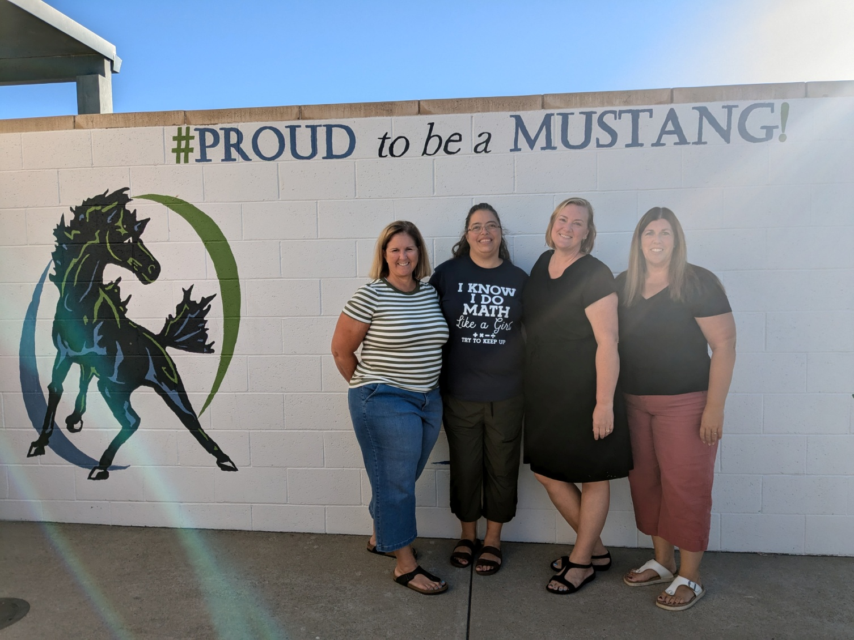
Welcome to Green Room!
Mrs. Schmich, Mrs. Boothby, Mrs. Watkins, Mrs. Thomas
Notes:
‹#›

Slide 2
Communication
All class-wide emails will come from green@mmcharter.org however, the account will not be monitored for replies.
chrystee@mmcharter.org
kthomas@mmcharter.org
bschmich@mmcharter.org
awatkins@mmcharter.org
Notes:
Alison
‹#›

Slide 3
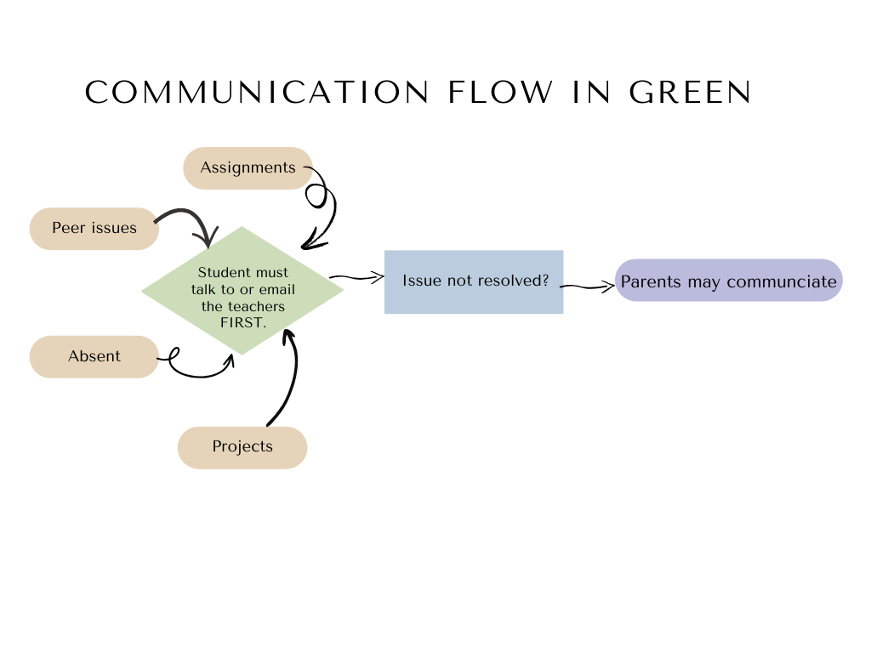
Communication
All parent-student communication must happen via the office phone.
Notes:
Alison
‹#›

Slide 4
Behavior & Discipline
Step 1: Redirection by teacher
Step 2: Silent Lunch
Step 3: Silent Lunch & Community Service
Step 4: Silent Lunch, Community Service, and meet with Mr. Boothby
Step 5: All of the above, plus a call home
Notes:
Chrystee
‹#›

Slide 5
Homeroom Activities
Write
Current Events
Strategy Games
Team Building
Art
Care of environment
Read aloud
Notes:
Kristin
‹#›

Slide 6
Google Classroom
Core subject areas have an active Google classroom.
Some work and resources will be posted in the classroom.
Students should check the GC daily.
Parents can sign up as a guardian.
This is our Distance Learning contingency.
Notes:
Kristin
‹#›

Slide 7
Technology
School issued ear buds will be used. No wireless/personal devices will be used.
Phones and smart watches will remain in backpacks during school hours unless otherwise directed by a teacher.
Devices will be confiscated if improperly used.
School provided laptops must be used in class.
Notes:
Chrystee
‹#›

Slide 8
When is work due?
Math is due by Friday at 8:30 a.m.
History, ELA, and Science are due on Thursday at 3:00 p.m., unless otherwise noted.
Literature Group assignments are due once a week on the assigned group day.
Don’t wait until the last minute to turn in work. Allow time for making corrections.
All corrections from the previous week are due by 8:30 a.m. the following Tuesday.
Notes:
Becky
‹#›

Slide 9
Homework
Unfinished daily/weekly work
Independent Projects
  Cultural Day in October
  Math project TBD
  Combined English/Science Project in Spring
(Details will be distributed when the projects are assigned)
Notes:
Becky
‹#›

Slide 10
Mustang Time and Intervention
This is a flexible work time where students can do any of the following:
Get assignment help
Ask questions
Work one-on-one or in a small group with a teacher
Utilize classroom resources/computers to complete assignments
Notes:
Chrystee
‹#›

Slide 11
Miscellaneous
No name papers will be tossed if not claimed by Friday.
Extensions may be granted on occasion, but only if asked by Wednesday.
Missing/late assignments may be accepted for partial credit. See individual teachers for details.
Work must be legible to earn credit.
Notes:
Kristin
‹#›

Slide 12


Grade Reports: Aeries
We will no longer be emailing reports, instead they will be accessible through the aeries portal at all times.
Make sure to regularly check the online portal or download the app for smart phones access.
Notes:
Kristin
‹#›

Slide 13
Grading Policy
Assignments are point based and graded for accuracy. Letter grades will be on report cards.
We expect students to complete corrections for the opportunity to earn full credit.
Some work is not correctable (summative work).
See individual teachers for specific details.
Notes:
Alison
‹#›

Slide 14
AI Policy
AI is not allowed for any work unless expressly stated by the teacher.
Any work that is determined to be completed with AI is considered plagiarism and a non-correctable score of zero will be given.
Notes:
Chrystee
‹#›

Slide 15
Student absences
Work from student absences must be completed!
Students must check in with the individual teachers upon return for lessons and assignments.
This is a student responsibility, not a teacher or parent responsibility.
Students can email during the absence to get a jump start on work, if desired.
For every day absent, students will get an additional day to complete the work without penalty.
Notes:
Kristin
‹#›

Slide 16
Independent Study
We need a minimum of three school days notice in order to prepare work.
Independent study must be applied for through the front office.
Independent study is due the morning you return (unlike an absence).
Independent study does not have the same capacity for corrections as standard assignments.
Notes:
Becky
‹#›

Slide 17
P.E.
Everyone will participate in a weekly mile run, on Fridays.
Everyone participates in PE activities at least three times a week.
All students must wear exercise appropriate shoes daily.
  If exercise appropriate shoes are not worn, students will lose points.
All students must have a note if they are not to participate in P.E.
  1-2 days out: parent note
  3+ days out: doctor’s note
Notes:
Becky
‹#›

Slide 18
History
7th Grade History will cover Medieval Times to Enlightenment. They will:
-Take notes
-Notebook
-Activities
-Assessments
-8th Grade History will cover The Colonies to Industrialization.
They will:
-Video Activities
-Notebook
-Activities
-Assessments
More details are on the class website in the Mrs. Schmich section.
Notes:
Becky
‹#›

Slide 19
English Language Arts
Work will be a combination of online and paper assignments.
Students will be completing writing assignments at frequent intervals. All of these assignments will be turned in to Google Classroom.
Students will complete short story units throughout the year.
Language jobs will work on grammar and language concepts.
More details are on the class website on the Mrs. Thomas section.
Notes:
Kristin
‹#›

Slide 20
Math
Course 2: Seventh grade
Course 3: Eighth grade/advanced seventh grade
Integrated 1: and advanced Eighth grade
In-Class: Students will be responsible for taking notes and participating in guided practice. Materials will be provided for storing work.
Outside-Class: Students will be responsible for completing assignments by the designated due date. Assignments must be completed in full to receive credit.
More details are on the class website on the Mrs. Boothby section.
Notes:
Chrystee
‹#›

Slide 21
Science
Science texts are online, through teachtci.com
8th graders will study Physical Science:
  Matter
  Waves
  Forces and Energy
7th graders will study Life Science:
  Cells and Genetics
  Ecosystems
  Adaptations
  See more details on the class website on the Mrs. Watkins section.
Notes:
Alison
‹#›

Slide 22
Literature Group
Literature group grades are in the ELA grade book, however students will have literature group with various teachers.
Students will be required to read outside of class and complete written work and participate in-class discussion and assignments. This is worth 30 points a week!
Groups will meet 1-2 times per week and assignments are due on those days. No late work is accepted for literature groups.
Notes:
Kristin
‹#›

Slide 23
Specials
Students will participate in elective style subjects each week to earn 30 points.
Grades will be earned and reflected on the report card.
Rotations last 7 weeks at a time.
  Mrs. Boothby: coding
  Mrs. Thomas: ASL
  Mrs. Schmich: Spanish vocabulary
  Mrs. Watkins: Spanish language culture, speaking and listening.
Notes:
Alison
‹#›

Slide 24
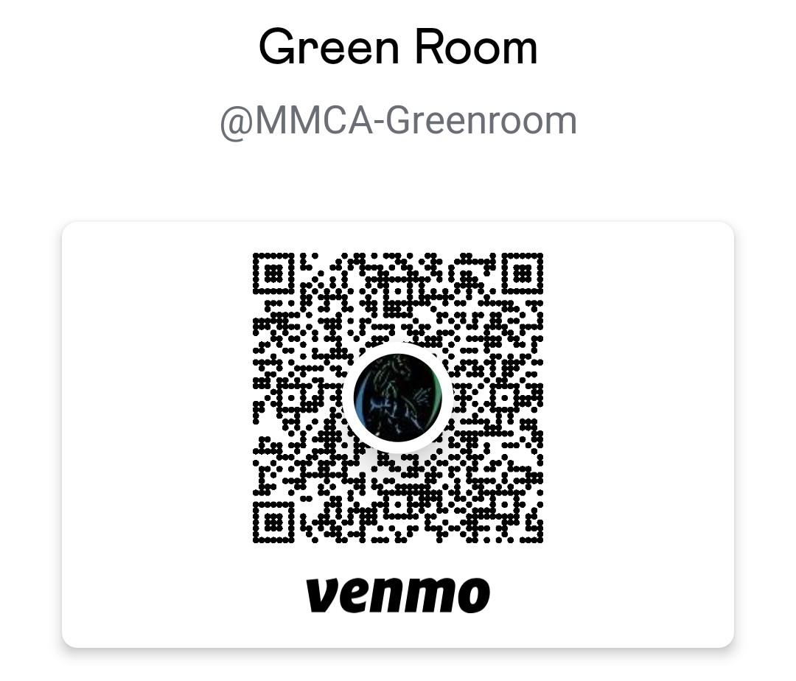
Field Trips
We typically go on a field trip once every two months or so.
Fees:
7th grade: $135
8th grade: $180 (includes graduation/Sunsplash)
Field trips are non-refundable (as we must prepay)
See the class website for more details
Payments
  accepted via check or Venmo @MMCA-Greenroom
  payment plans granted on request
  due by September 5, 2025
  Make sure that your required driver info is updated via the office.
Notes:
Becky
‹#›

Slide 25


Enrichment
Enrichment activities include cooking, art, character education, social-emotional learning, garden.
Participation is required and will be added into the specials grade.
If you would like to volunteer for one of these enrichments, please see Mrs. Schmich.
Notes:
Chrystee
‹#›

Slide 26
CERT
The Teen Community Emergency Response Team (Teen CERT) educates students in disaster preparedness for hazards that could affect their school and trains them in basic response skills.
CERT students learn how to be first responders at a school disaster scene. The program will culminate in a student exercise of a mock disaster during the Spring.
Notes:
Chrystee
‹#›

Slide 27
Washington D.C.
Tentatively scheduled for June 2026
7th and 8th graders are invited to attend, minimum number of students required.
Contact Mrs. Boothby if you have any questions and for cost information chrystee@mmcharter.org
Notes:
Chrystee
‹#›

Slide 28
Wish List
Amazon Wish List
Money is always appreciated too.
Checks can be made out to
MMCA Green Room or sent via Venmo @MMCA-Greenroom
$10= 1 volunteer hour
Notes:
Becky
‹#›

Slide 29

Volunteering Opportunities
Field Trip Drivers
Graduation Help
Garden Docent
Art Docent
Cooking Docent
Room Parent
Watch D.O.G.S.
Copy Helper
Email Mrs. Schmich bschmich@mmcharter.org
Notes:
Becky
‹#›

Slide 30
















Thank you for supporting our class!
Notes:
‹#›

